Slide 1
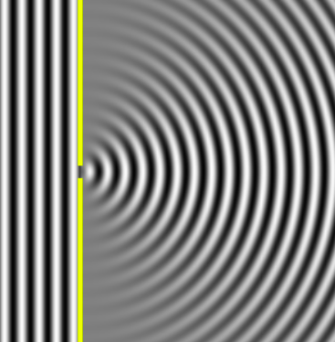
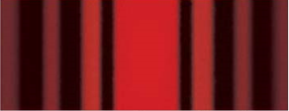
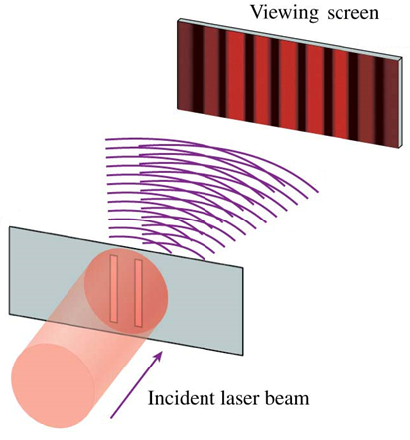
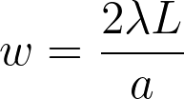
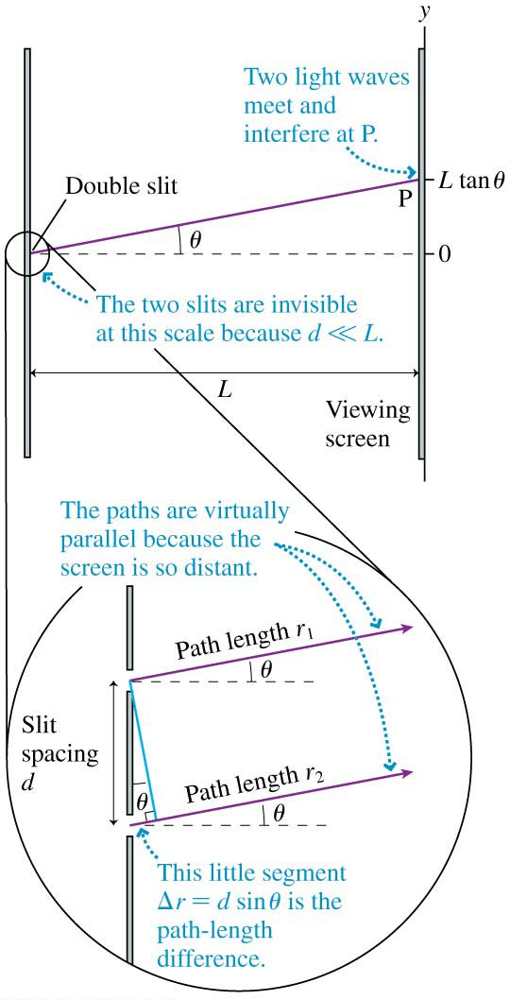
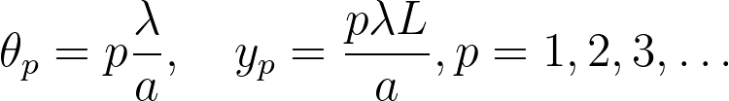
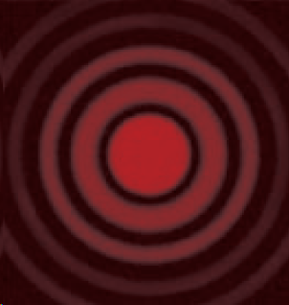
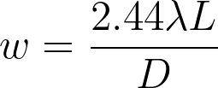
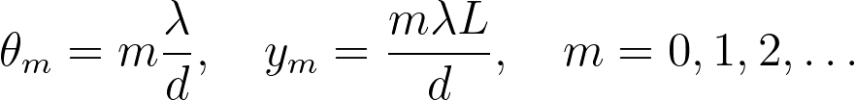
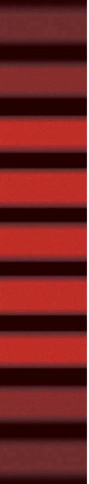

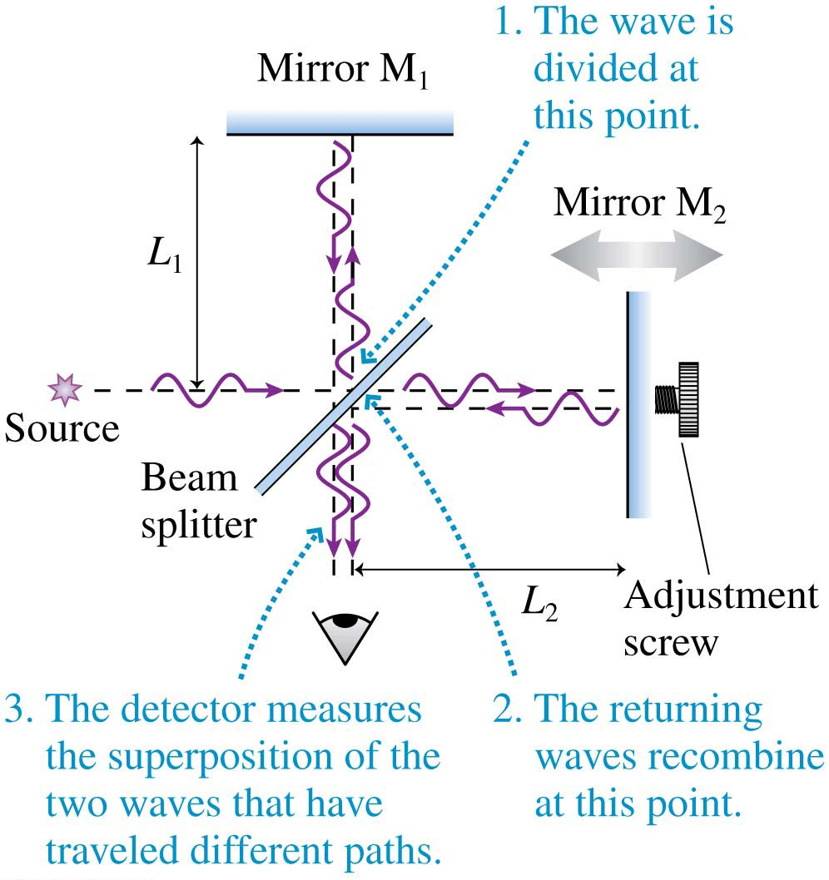

11
Light – Wave Optics
Wave Model of Light
Light travels as a wave through space. It displays:
diffraction: spreading of the wave after emerging from an aperture.
interference: due to overlap of waves. Constructive interference occurs when crest meets crest, while destructive interference occurs when crest meets trough.
Huygens Principle
Each point on a wave front (surface of constant phase) is the source of a spherical wavelet. The interference of these wavelets forms the wave front at any later time.
Single Slit
When light of wavelength λ passes through
a single slit of width a the diffraction
pattern displayed on a screen shows a
bright central maximum of width
surrounded by weaker fringes.
Dark fringes are located at angles and positions at
If the aperture is circular instead of a slit,
the width of the central maximum is
The wave model for light is valid when the aperture < 1 mm in size.
θ_{p}
$$⟷$$
y_{p}
L
w
Young’s Double Slit Experiment
Light illuminates the double slits of separation d and the waves from each slit spread out behind the slit and interfere. A screen placed a distance L from the slits shows the interference pattern.
Constructive interference (resulting in a bright fringe) occurs when both waves arrive in phase at P.
The order m denotes the m^{th} bright fringe starting with m = 0 at the center.
Bright fringes are equally spaced and located at
Descructive interference (resulting in a dark fringe) occurs when both waves arrive out of phase at P. They are located exactly halfway between the bright fringes:
Diffraction Grating
A diffraction grating is a periodic array of closely packed slits. It is the basis of spectroscopy.
When light passes through a diffraction grating with adjacent
slits spacing d, the interference pattern shows very
bright and narrow fringes at
We can’t use the small angle approximation here.
L
θ_{m}
y_{m}
The Michelson Interferometer
is used to make very precise measurements with light waves.
Constructive interference: L₂ - L₁ = m λ/2 m = 0, 1, 2 …
Destructive interference: L₂ - L₁ = (m + 1/2) λ/2
Electricity and Magnetism
Joseph D. MacMillan | Licensed under CC BY-NC-SA 4.0.

